Slide 1
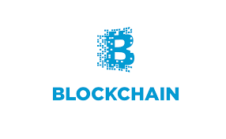
Mastering Blockchain with JS Blockchain Concepts

Slide 2

Overview
Blockchain Concepts
Blockchain Fundamentals
Working of Blockchain
Use Cases
Blockchain Web application

Slide 3
Fundamentals
Blockchain Concepts
Tracing origin
Shortcomings of current transaction systems
Emergence of Bitcoin
Birth of blockchain

Slide 4
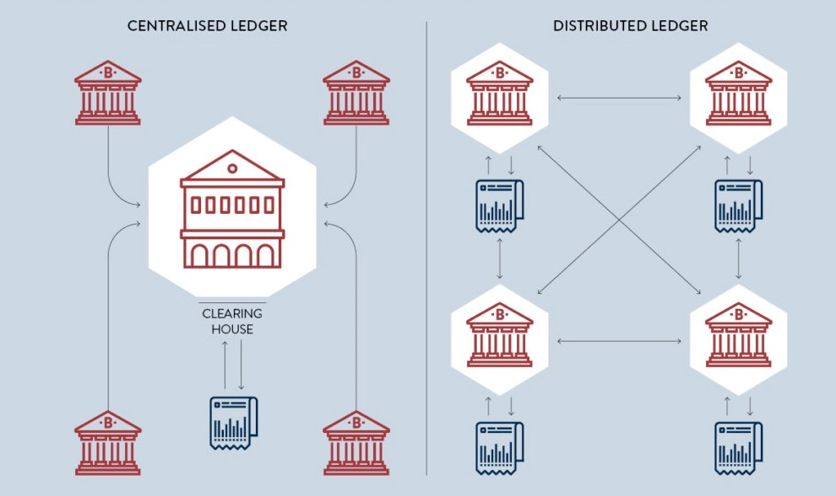
Traditional Business Network
Blockchain Concepts

Slide 5
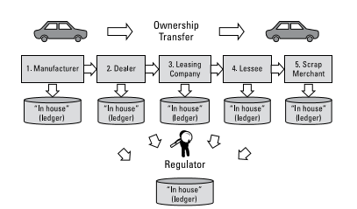
Tracking Ownership without Blockchain
Blockchain Concepts

Slide 6
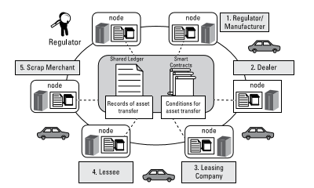
Tracking Ownership with Blockchain
Blockchain Concepts

Slide 7
Key Business Benefits
Blockchain Concepts
Benefits with Blockchain
Time savings
Cost savings
Tighter security and privacy
Improved auditability and efficiency
Notes:
MongoDB provides rich semantics for reading and manipulating data. CRUD stands for create, read, update, and delete.

Slide 8
Building Trust with Blockchain
Blockchain Concepts
Distributed and sustainable
Secure, private and indelible
Transparent and auditable
Consensus based and transactional
Flexible

Slide 9
Blockchain
Why its called blockchain?

Slide 10
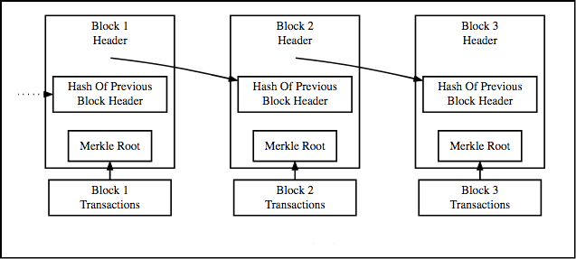
Transaction records with blocks
Blockchain Concepts

Slide 11
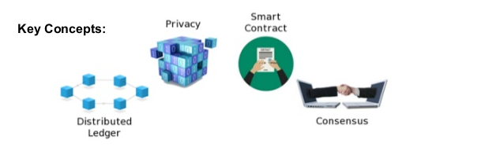
Terminologies
Blockchain Concepts

Slide 12
Terminologies
Blockchain Concepts
Shared Ledger
Permissions
Consensus
Smart Contracts

Slide 13
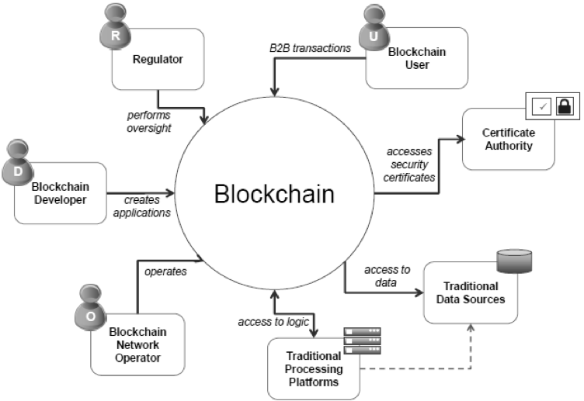
Participants and Roles
Blockchain Concepts

Slide 14
Participants and Roles
Blockchain Concepts
Blockchain user
Regulator
Blockchain developer
Network operator
Platforms and data sources

Slide 15
Working

Slide 16
How Bitcoin and Blockchain different?
Blockchain Concepts
Are Bitcoin and Blockchain the same thing?
How does Bitcoin work?
How is bitcoin for blockchain different?
Blockchain Transformation

Slide 17
Propelling Business with Blockchain
Blockchain Concepts
Types of Market Friction
Friction-Free Business Networks
Ecosystems Transformation

Slide 18
Use Cases
Blockchain Concepts
Financial Services
Insurance
Government
Supply Chain Management
Healthcare

Slide 19
Steps to create Blockchain Application
Blockchain Concepts
Steps to your Blockchain Application
Choosing a proper Use Case
Goal of Blockchain Network
Blockchain Provider and Platform
Developing and Deploying Chain code

Slide 20
Decentralized Application
Blockchain Concepts
It runs on decentralized peer-to-peer network which has a source code as open-source.
No single node has complete control over DApp.
Example:
Bitcoin DApp uses the blockchain data structure.

Slide 21
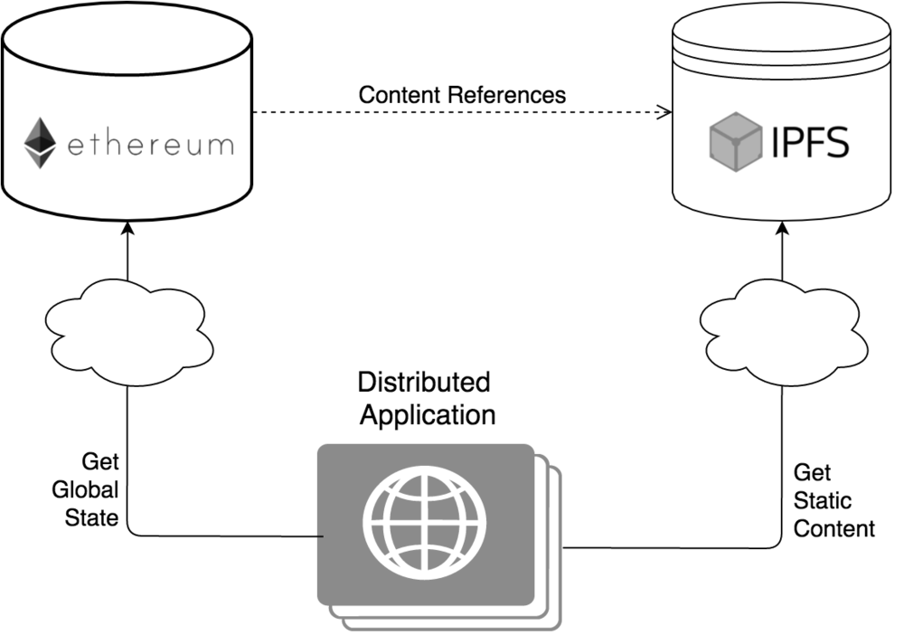
DApps
Blockchain Concepts

Slide 22
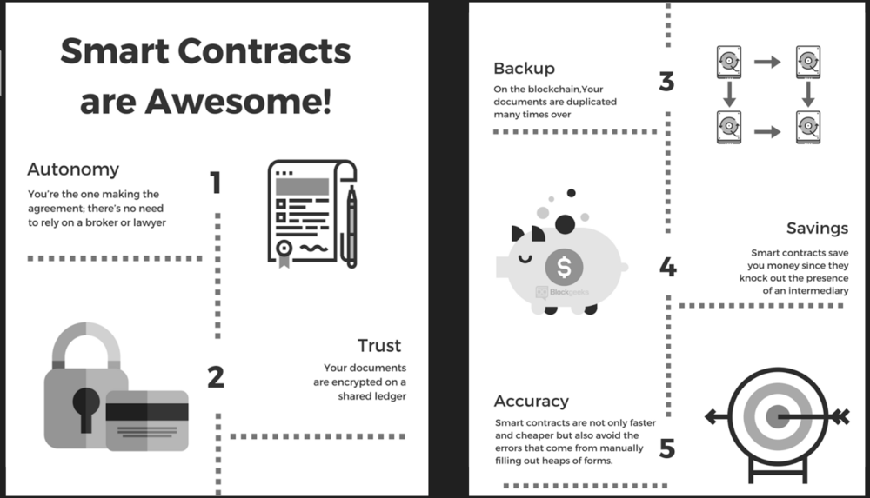
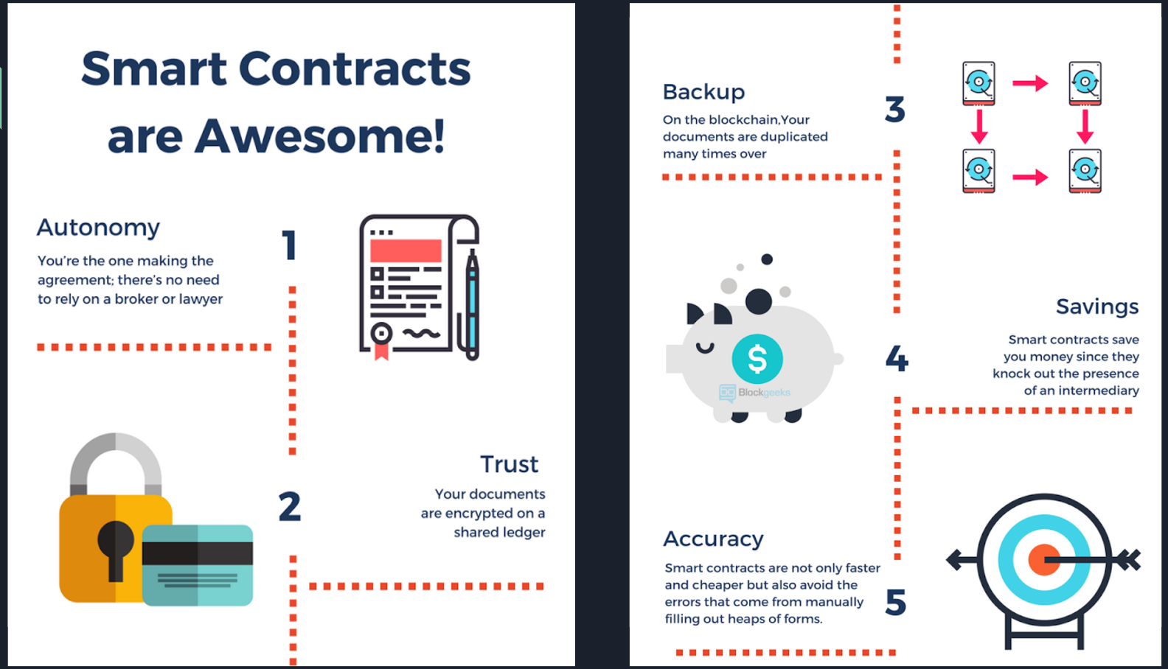
Smart Contract Structure
Blockchain Concepts

Slide 23
Ethereum
Blockchain Concepts
Decentralized Platform
Written using smart contracts
Internal currency called Ether
Ether is best example of crypto-currency
Blockchain based

Slide 24
Geth
Blockchain Concepts
Go-Ethereum.
CLI Application.
Written in Go Programming Language.
Available for major operating systems.
Geth is available for OS X, Linux and Windows.

Slide 25
Solidity
Blockchain Concepts
High level language
It is designed to compile to code Ethereum Web Application.
To use the latest stable version of the Solidity compiler via Node.js you can install it via npm:
npm install solc

Slide 26
Different Data Types
Blockchain Concepts
Arrays
Strings
Structs
Enums
Mappings

Slide 27
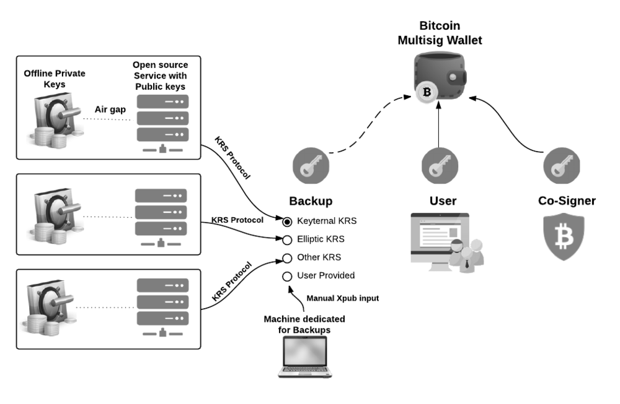
Bitcoin
Blockchain Concepts

Slide 28
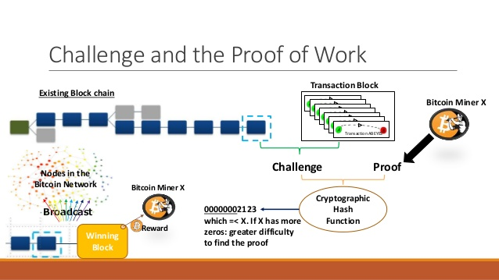
Blockchain Proof of Work
Blockchain Concepts

Slide 29
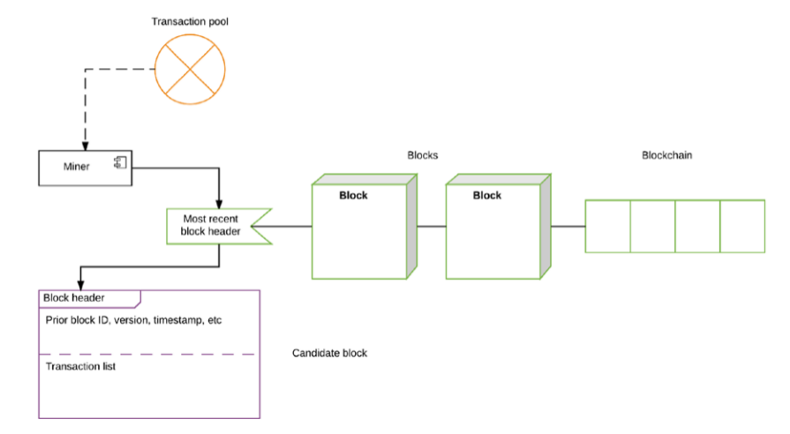
Bitcoin
Blockchain Concepts

Slide 30
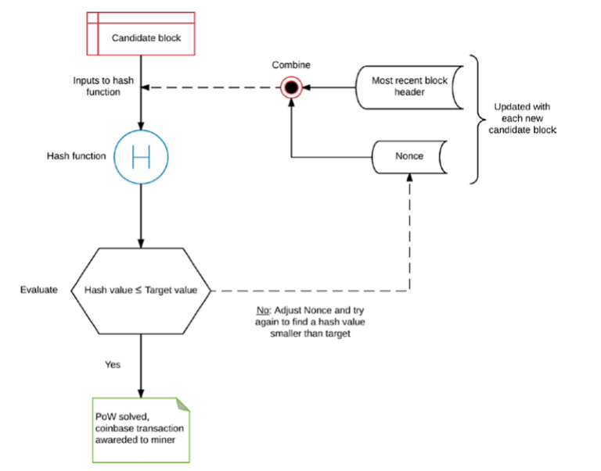
Bitcoin Proof- of- Work
Blockchain Concepts

Slide 31
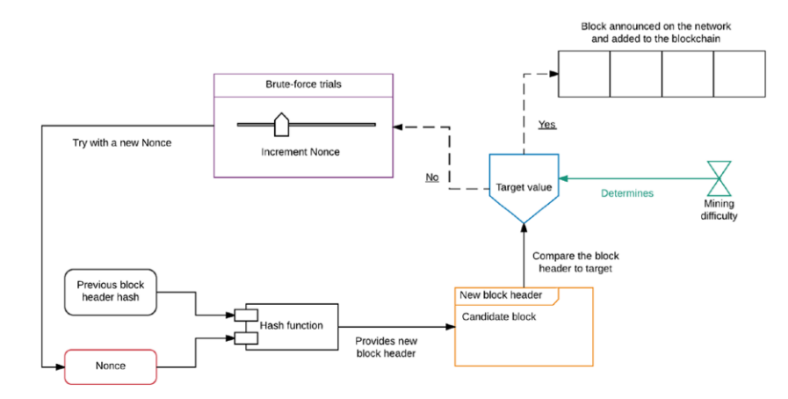
Solving of Proof of Work
Blockchain Concepts

Slide 32
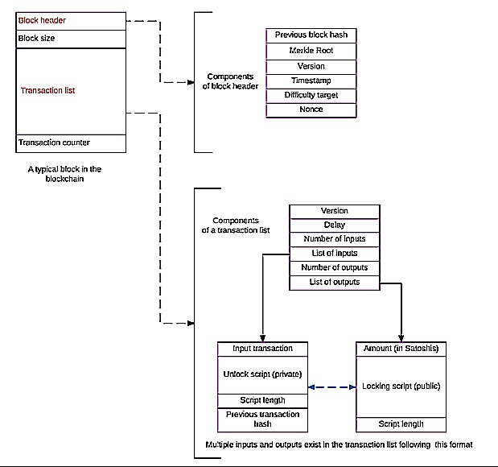
Transaction Workflow
Blockchain Concepts

Slide 33
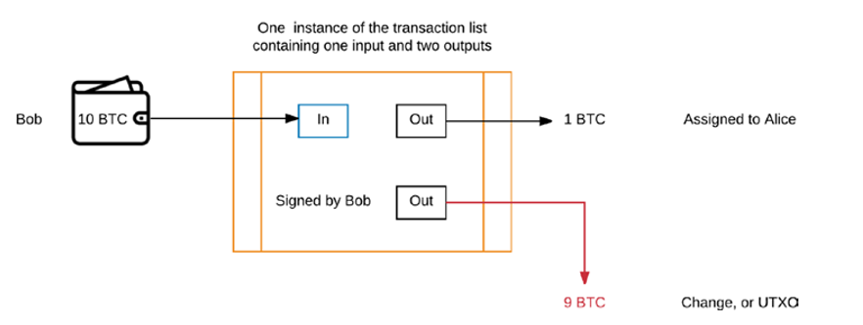
UTXO
Blockchain Concepts

Slide 34
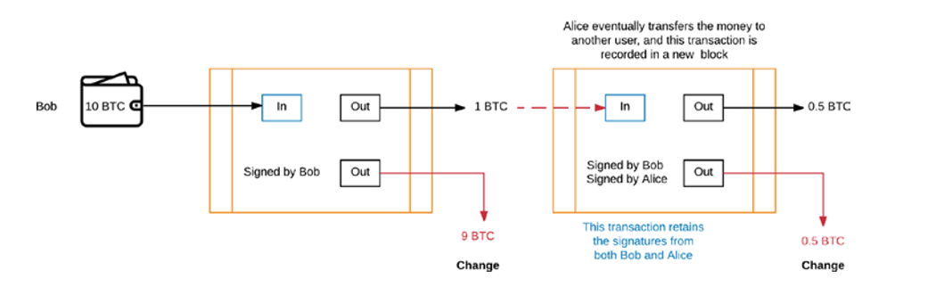
Transactions on the Blockchain
Blockchain Concepts

Slide 35
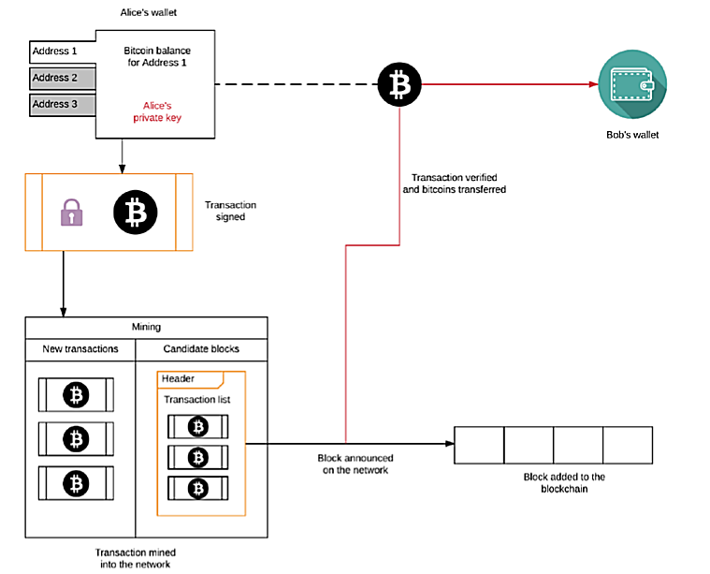
Transaction on Network
Blockchain Concepts

Slide 36
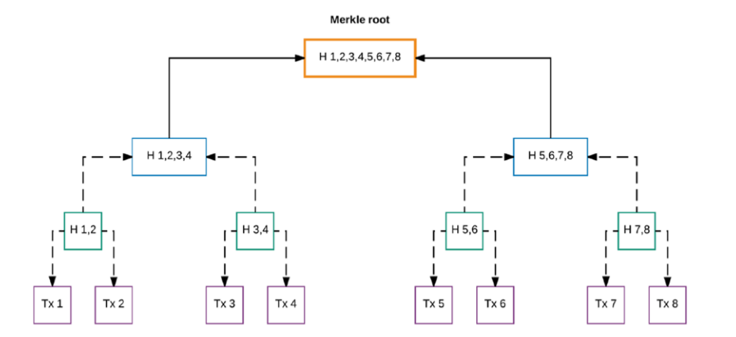
Merkle Root
Blockchain Concepts

Slide 37
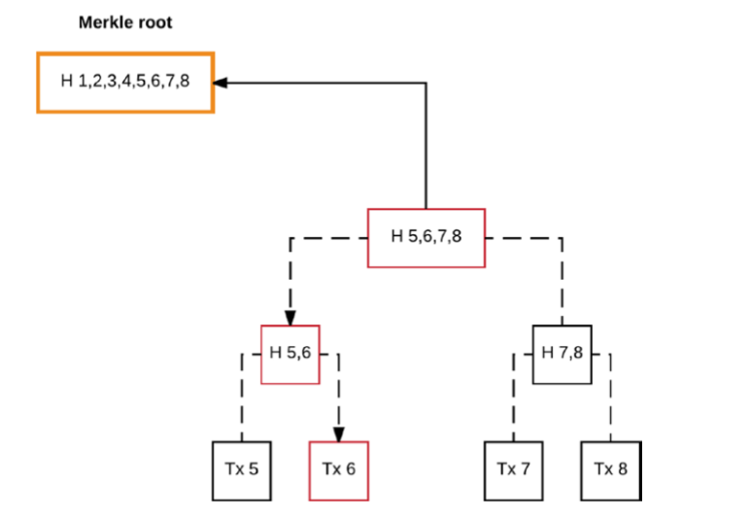
Finding a transaction using Merkle Root
Blockchain Concepts

Slide 38
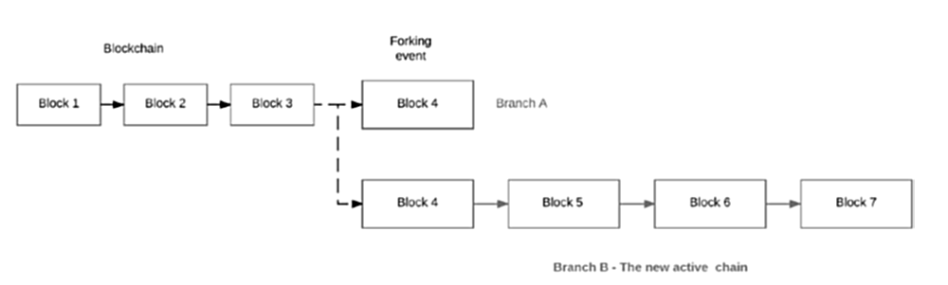
Forks on Blockchain
Blockchain Concepts

Slide 39
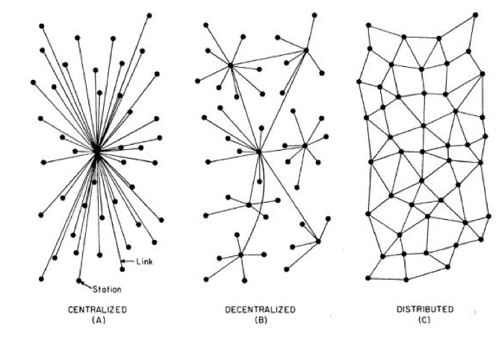
Decentralized Applications
Blockchain Concepts

Slide 40
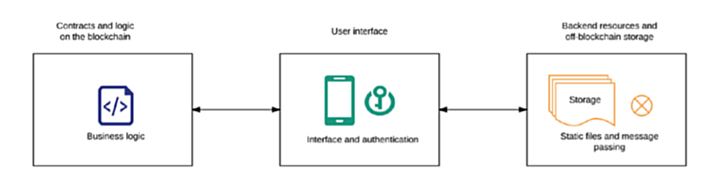
Structure
Blockchain Concepts

Slide 41
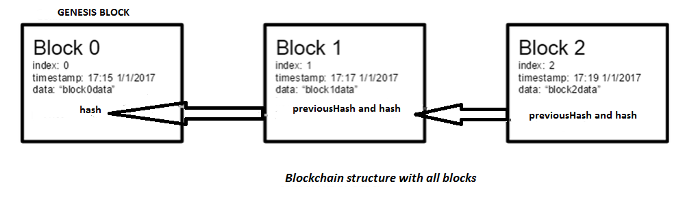
Structure of Block
Blockchain Concepts

Slide 42
NPM packages
Blockchain Concepts
Cryptography Plugin npm install crypto-js
Express JS npm install express
Body Parser npm install body-parser
WebSocket npm install –save ws

Slide 43
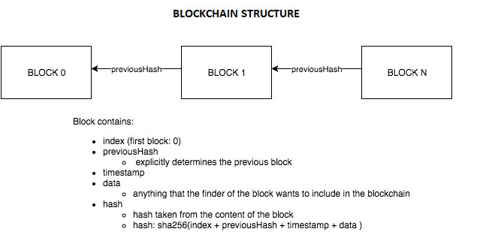
Blockchain Structure
Blockchain Concepts

Slide 44
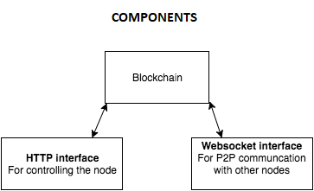
Components
Blockchain Concepts

Slide 45
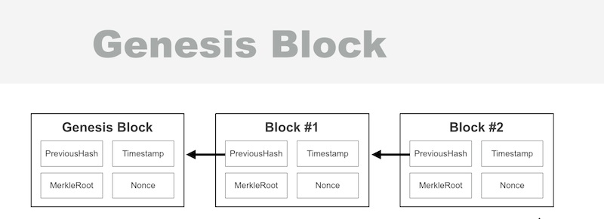
Genesis Block
Blockchain Concepts

Slide 46
Impact of Blockchain in Financial Sector
Blockchain Concepts
Ripple
Smart Contracts to trade derivatives
Scope of blockchain
Fraud reduction
KYC and Trading platforms

Slide 47
Impact
Health Sector

